Slide 1
Delivery Supply Chain Integrity
Tekton and SPIRE Attestion

Slide 2
Tekton Delivery Supply Chain Integrity
Problem
When code, docker files, and ansible playbooks are hosted in the public repositories, like GitHub:
Attackers can tamper the code integrity, destroy files or embed malicious programs
Developers can unintentionally modify code, or push wrong files
How to reduce the vulnerability and guarantee the integrity of the code in a secure and automated way?

Slide 3
Tekton Delivery Supply Chain Integrity
Problem
When code, docker files, and ansible playbooks are hosted in the public repositories, like GitHub:
Attackers can tamper the code integrity, destroy files or embed malicious programs
Developers can unintentionally modify code, or push wrong files
How to reduce the vulnerability and guarantee the integrity of the code in a secure and automated way?
Solution
Tekton pipeline running an Ansible playbook on Kubernetes, signs the pod to guarantee the integrity of the code
The signing pipeline can be combined with CI/CD pipeline as a part of product development
The signature ensures the code is signed by a valid signer, and allows detection of any repository tempering attack, by simply verifying the code signature with a public key of the signer
The signing key is managed as a Kubernetes secret or embedded in the docker image of the signing pod

Slide 4

Example: Tekton Delivery Supply Chain Integrity
GitHub
Repository
4. Push repo
with signature
using git command
2. Pull repo
1. Start Tekton pipeline
Tekton Pipeline
Controller Pod
/ Webhook Pod
Signing Container
Signing Pod
Node
3. Sign repo with a signing key, and generate signature by running ansible playbook of integrity, using the signing key

Slide 5
Example: Tekton Delivery Supply Chain Integrity
GitHub
Repository
4. Push repo
with signature
using git command
2. Pull repo
1. Start Tekton pipeline
Tekton Pipeline
Controller Pod
/ Webhook Pod
Signing Container
Signing Pod
Node
3. Sign repo with a signing key, and generate signature by running ansible playbook of integrity, using the signing key
Problem
The Signing Key must be securely delivered to the Tekton pipeline, but nowhere else
The Signing Key cannot be embedded with pipeline; therefore, it must be handled by trusted human administrator, preventing automation
The Signing Key can be read by anyone with an exec access to the Signing Container
The Signing Key remains static and cannot be easily changed without human interaction

Slide 6
Tekton Delivery Supply Chain Integrity w/ SPIRE
Problem
The Signing Key must be securely delivered to the Tekton pipeline, but nowhere else
The Signing Key cannot be embedded with the pipeline; therefore, it must be handled by the trusted human administrator, preventing automation
The Signing Key can be read by anyone with an exec access to the Signing Container
The Signing Key remains static and cannot be easily changed without human interaction
Solution w/ SPIRE
The key (or set of keys) remain stored securely in Vault
Different keys are used for different pipelines reducing the blast radius
The keys are periodically rotated
The Vault policies enforce what pipelines can get access to what keys based on the pipeline (workload) identity managed by SPIRE
The Sidecar Container, assisting the Signing Container, manages the Identity Token and requests the Signing Key from the Vault on the behalf of the Signing Pod
The SPIRE Agent is attested by the Kubernetes platform

Slide 7


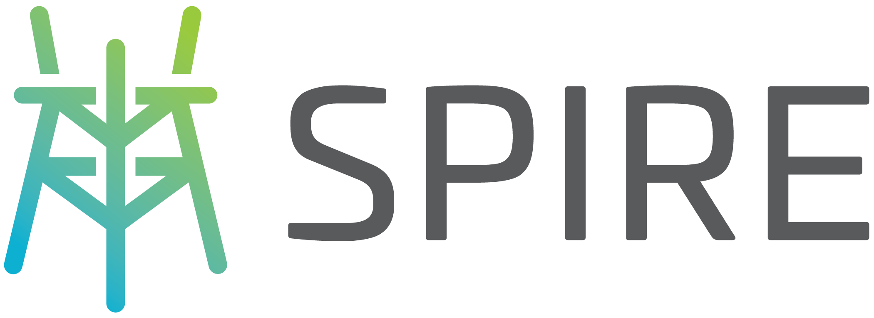
Identity Based Secret Distribution with SPIRE
GitHub
Repository
policies
3. Sidecar uses Identity Token to obtain the Signing Key and passes it to the Signing Container
1. CISO injects the Signing Key to Vault and sets up the Identity Policies
Tekton Pipeline
Controller Pod
/ Webhook Pod
Sidecar Container
Signing Container
Signing Pod
2. Sidecar gets Identity Token for a Signing Pod
from SPIRE
Spire Ag
Node

Slide 8
Identity Based Secret Distribution with SPIRE
GitHub
Repository
policies
3. Sidecar uses Identity Token to obtain the Signing Key and passes it to the Signing Container
1. CISO injects the Signing Key to Vault and sets up the Identity Policies
Tekton Pipeline
Controller Pod
/ Webhook Pod
Sidecar Container
Signing Container
Signing Pod
2. Sidecar gets Identity Token for a Signing Pod
from SPIRE
Spire Ag
Node
New Problem
Even though the Workload Identity is tied to Kubernetes, it is not tied to the hardware, infrastructure or a Cloud Provider
Can we really trust the host? Do we know what is running there?
Underlying software stack might have been tampered with

Slide 9
Tekton Delivery Supply Chain Integrity w/ SPIRE
New Problem
Even though the Workload Identity is tied to Kubernetes, it is not tied to the hardware, infrastructure or a Cloud Provider
Can we really trust the host? Do we know what is running there?
Underlying software stack might have been tampered with
Solution w/ SPIRE + Keylime + TPM/vTPM
Node is attested by Keylime (and TPM). This ties the Workload Identity with Hardware Root of Trust:
It guarantees the identity of the node beyond any doubt
It attests the software stack, from booting to the kernal. Enforcement of the software bill of materials (SBOM) We know the firmware, packages, libraries
It measures and enforces the integrity of files (IMA)
Comments:
Keylime *servers* are trusted. Nodes on which Keylime agent runs are *not* trusted.
The node stored private key must be well protected after it has been injected by Keylime, so no other entity can use it to sign other attestation challenges.

Slide 10
“Keylime guarantees the identity of a node beyond doubt”
That’s a bold claim. Concepts and technologies that make this possible:
Endorsement Key aka EK – private/public keypair unique to a TPM device. Private key is locked forever inside the device. The identity of the TPM device is provable modulo RSA or ECC collisions (we are not there yet).
EK certificate – proves the TPM genuine by (a) signing the EK (b) signed by TPM manufacturer root CA
Measured Boot Attestation aka MBA – a technique to identify (“measure”) and validate (“attest”) every component of the software stack as it is being built up during boot.
Integrity Measurement Attestation aka IMA – a technique to measure each executable in a running operating system and attest that it genuine.
Root of trust: one of several hardware techniques to ensure TPM device is initialized before any other SW runs on machine, and therefore TPM initialization is not “contaminated”
Chain of trust: i.e. “measure before you run” – each component of the software stack measures the next piece before it runs. Measurement digests are recorded in the TPM device.
Remote attestation -- perform TPM identity test, MBA, IMA and possibly other checks on a host *remotely*.
The untrusted node records MBA and IMA measurements, also recording digests in the TPM device
The [verifiably] genuine TPM provides an unfalsifiable record of the digests above
The MBA and IMA measurements, and a TPM “quote” are downloaded to a remote (trusted) keylime server
The server authenticates the measurements using the TPM quote
The server checks measurements against the SBOM and declares attestation success or failure.
Keylime (https://github.com/keylime/keylime ) is an open-source implementation of remote attestation.

Slide 11
Tekton Delivery Supply Chain Integrity w/ SPIRE + Keylime + TPM
SPIRE Nodes Attestation
Root CA stored securely on the SPIRE Server
Root CA signs an intermediate CA for distributions
Keylime executes a suite of attestations and checks before verifying a node
Once the node is verified, Keylime delivers an intermediate CA to a specific node (encrypted; cannot be read on a different host)
Verified node creates node x509 signed with intermediate CA
SPIRE agent uses x509 to attest with SPIRE Server
When SPIRE Agent is successfully attested, SPIRE Server assigns identity for it and for all the workloads hosted by this node
Future Extensions/Optional:
x509 can be used only once
once the SPIRE node is attested, keys destroyed, so no other entity can use it to sign other attestation challenges. [optional]
periodic/continuous attestation with new keys

Slide 12



Node Attestation with TPM and Keylime
GitHub
Repository
policies
3. Node attested by SPIRE with x509 POP
Tekton Pipeline
Controller Pod
/ Webhook Pod
Sidecar Container
Signing container
Signing Pod
Spire Ag
Node
Root CA
Keylime Ag
TPM
2. Keylime delivers x509 securely
1.Keylime attests the node

Slide 13
Node Attestation - SPIRE Server
keep Root CA private key secure and Certificate for validation
create Intermediate CA key and sign Intermediate Certificate to be distributed to worker nodes
Steps:
Generate rootCA key --> rootCA.key
Create rootCA cert (rootCA.key) --> rootCA.pem
Generate intermediate Key --> interim.key
Create intermediate cert (interim.key, rootCA.key, rootCA.pem) --> interim.pem
Server NodeAttestor just needs the rootCA cert for verification (rootCA.pem)
NodeAttestor "x509pop" {
plugin_data {
ca_bundle_path = "/opt/spire/sample-keys/rootCA.pem"
}
}

Slide 14
Node Attestation - SPIRE Agent
obtain Intermediate CA and key
create node Certificate signed with Intermediate CA and store on the host
submit it to SPIRE Server for verification
Steps (for every Worker Node):
Deliver securely iterim.pem and interim.key to each hosting node
Generate node key --> node.key
Create node cert (node.key, interim.key, interim.pem) --> node.pem
and store them securely on the node
SPIRE Agent uses node.key and a cert bundle (node.pem + interim.pem) --> cert.pem
The files should be stored on individual hosting nodes
plugins {
NodeAttestor "x509pop" {
plugin_data {
private_key_path = "/run/spire/agent/node.key.pem"
certificate_path = "/run/spire/agent/node-bundle.cert.pem"
}
}

Slide 15

SPIRE Server
Root CA
Root CA
Intermediate CA
1. Root CA signs Intermediate CA
Intermediate CA
2. Intermediate CA key + cert delivered securely to Cluster
4. SPIRE Attests the Node with Root CA
Hosting Cluster
Intermediate CA
Intermediate CA
Hosting Node
Node Bundle
AG
Node Key
Key and Certificate Management for x509 POP attestation
3. Node Key created to sign the Node Bundle

Slide 16
SPIRE Server
Root CA
Root CA
Intermediate CA
1. Root CA signs Intermediate CA
Intermediate CA
2. Intermediate CA key + cert delivered securely to Cluster
4. SPIRE Attests the Node with Root CA
Hosting Cluster
Intermediate CA
Intermediate CA
Hosting Node
Node Bundle
AG
Node Key
Key and Certificate Management for x509 POP attestation
3. Node Key created to sign the Node Bundle

